Slide 1
Computer Vision & Clinical Natural Language Technology for Health Care
Abarna Sivaprakasam

Slide 2
AGENDA
Past, Present, and Future approaches to Computer Vision & NLP in Healthcare.
Hackathon Proof of Concept

Slide 3
ANALYZING TRENDS
Past Approaches | Present Approaches | Future Approaches
Challenges in maintaining organized records. | AI as a pivotal element in healthcare. | AI tools accelerating drug development.
Need for swift data retrieval and analysis. | Leveraging Computer Vision, NLP, and data analytics. Example: Extracting prescription information using Azure and OpenAI | Vision-guided surgeries for accurate diagnoses.

Slide 4
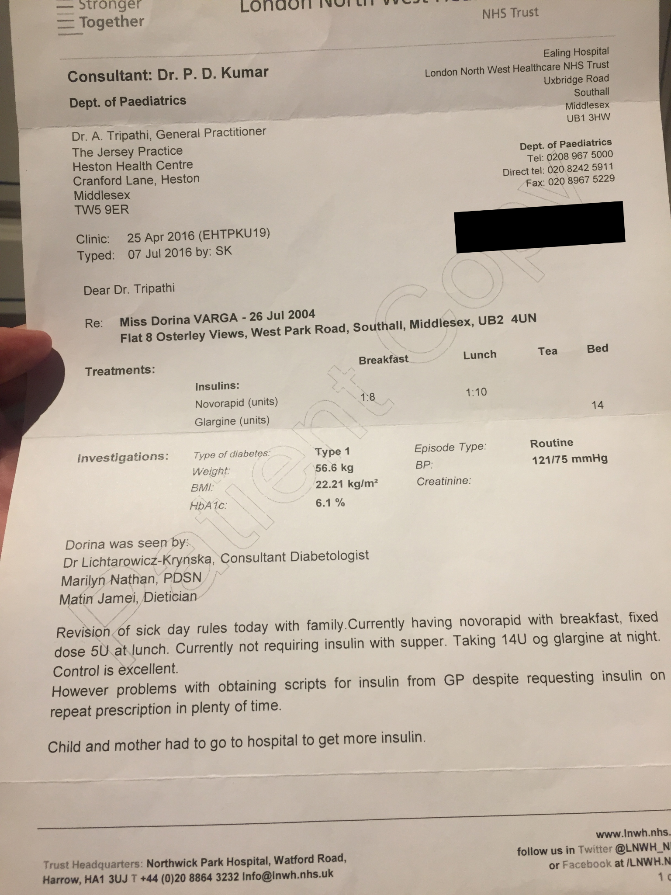
Computer vision and NLT
Here we have taken printed prescription images of a diabetic patient and extracted the words using Azure Document Intelligence API

Slide 5
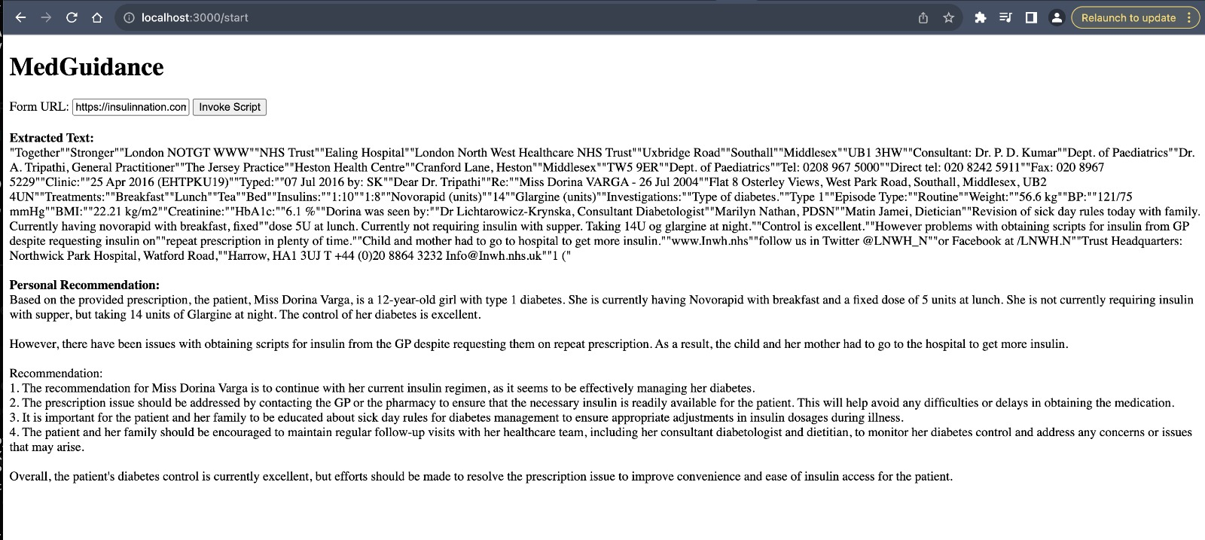
utilized Open AI API to derive personal recommendations.
Utilized OpenAI API to derive personal recommendations.

Slide 6
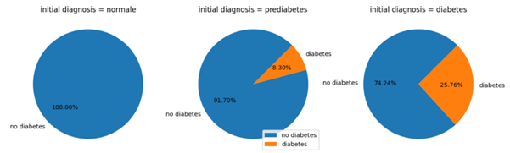
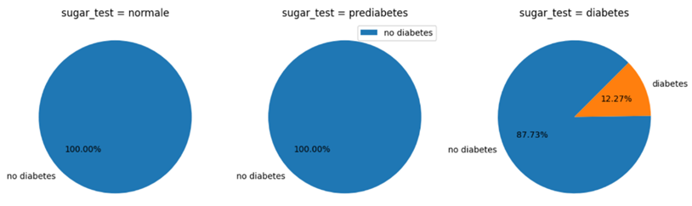
Diabetes Prediction Analysis
Utilization of Kaggle's "diabetes prediction" dataset.
Key findings: average age, HbA1C levels, blood glucose levels are the main factors for diabetes

Slide 7
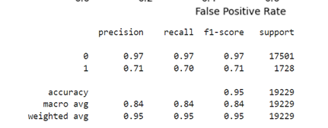
LOGISTIC REGRESSION
Training a Logistic Regression model.
Initial accuracy: 95.72%.
Precision and recall metrics for diabetes prediction
Balancing precision (0.71) and recall (0.70).
Maintaining accuracy at 95%.

Slide 8
PROPOSED IDEAS FOR COTIVITI
Prioritize explainable AI models.
Transparency in decision-making.
Real-time analytics for healthcare optimization.

